Slide 1


Trends in US Breweries
A repot prepared by Tajar, Inc.
Rajat Chandna, Andy Ho, An Nguyen, Jodi Pafford, and Tori Wheelis

Slide 2
The TAJAR, Inc Team:
Rajat Chandna
Andy Ho
An Nguyen
Jodi Pafford
Tori Wheelis

Slide 3
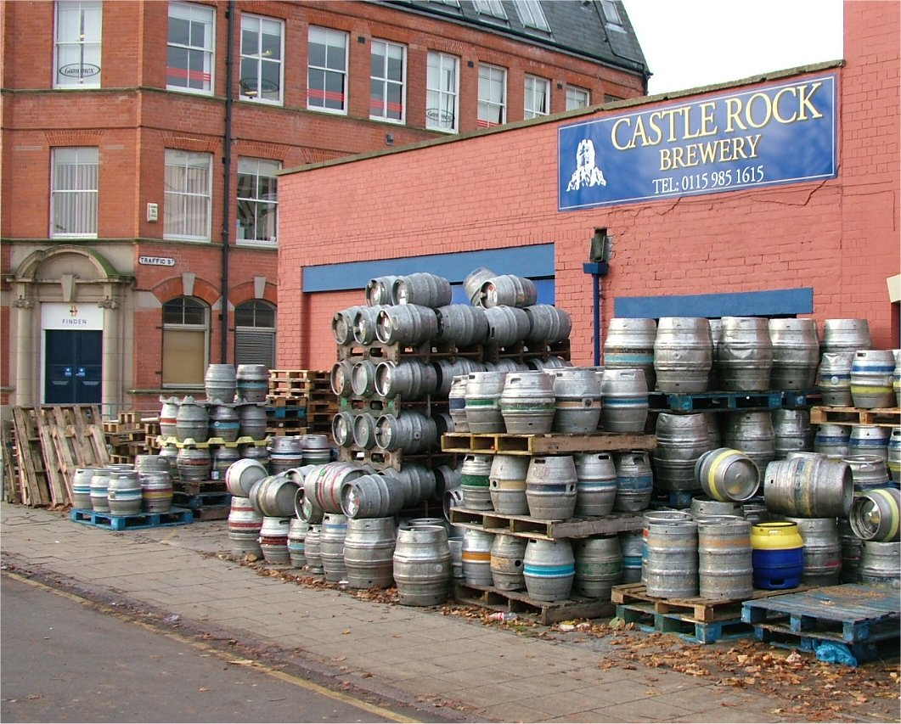
The Brewery File:
Data File with Brewery Information
This Photo by Unknown Author is licensed under CC BY-SA
This Photo by Unknown Author is licensed under CC BY-NC-ND

Slide 4
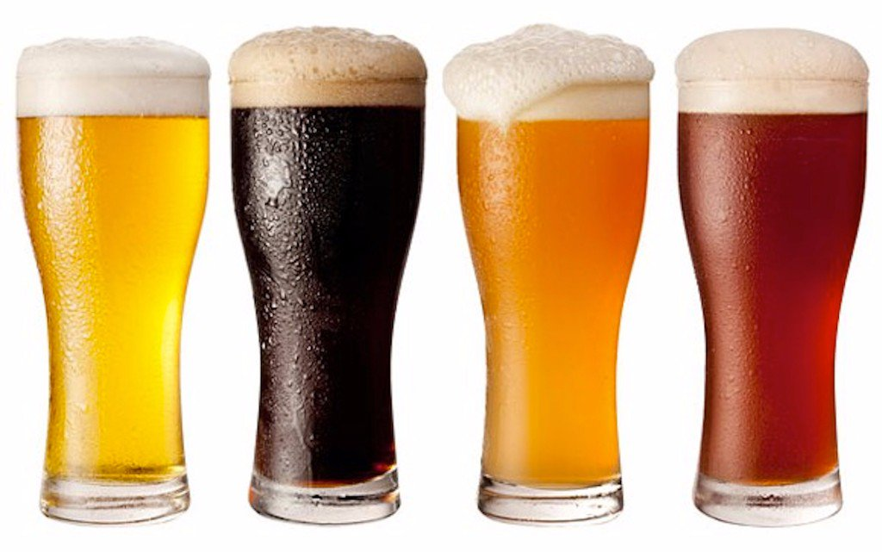
The Beers File:
Data File with Beer Information

Slide 5
Example of Data
Insert Data for Question 2 – Print the first 6 observations and the last 6 observations.

Slide 6
Further Discoveries:
Insert data for question 3 – How many N/As are in each column

Slide 7
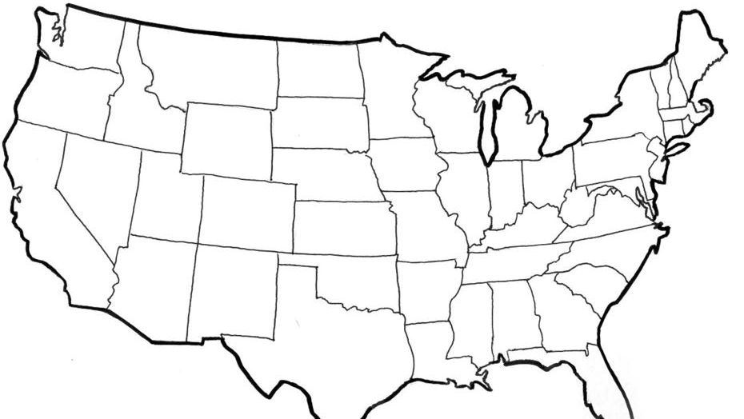
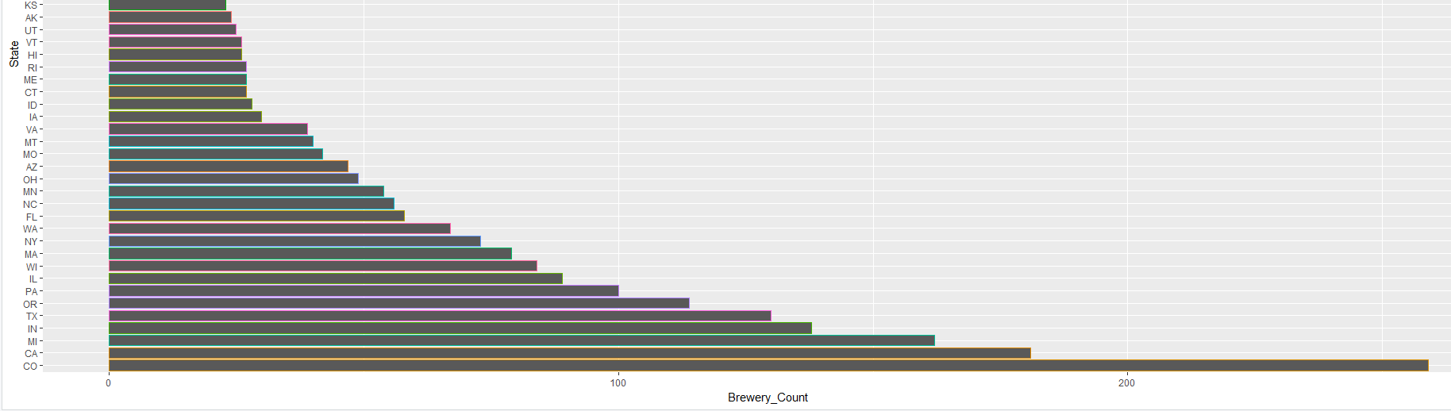
US Brewery Locations
This Photo by Unknown Author is licensed under CC BY-SA

Slide 8
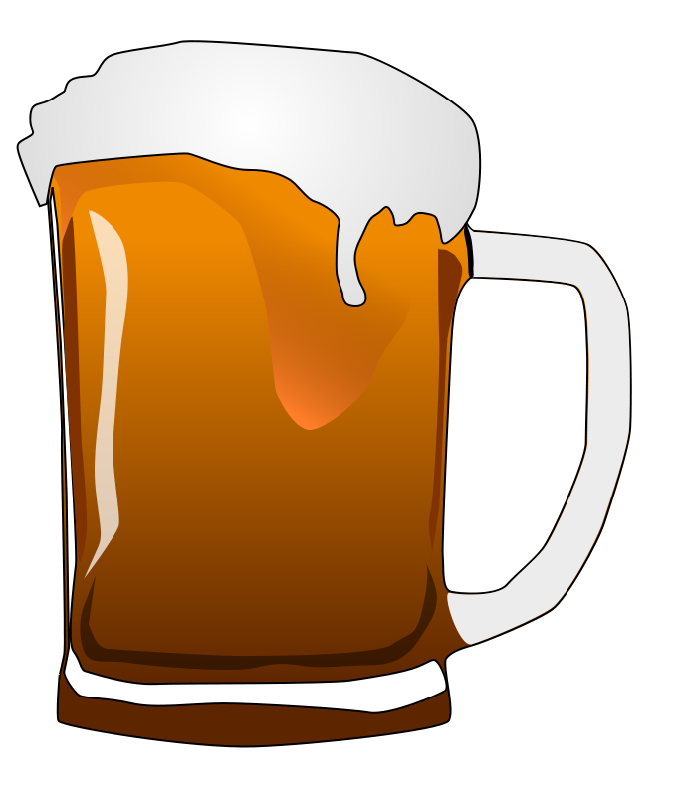
Median Alcohol Content & International Bitterness Units
Highlight a few states from question 4 – Median alcohol content and international bitterness units

Slide 9
Median Alcohol Content & International Bitterness Units
Highlight a few states from question 4 – Median alcohol content and international bitterness units

Slide 10
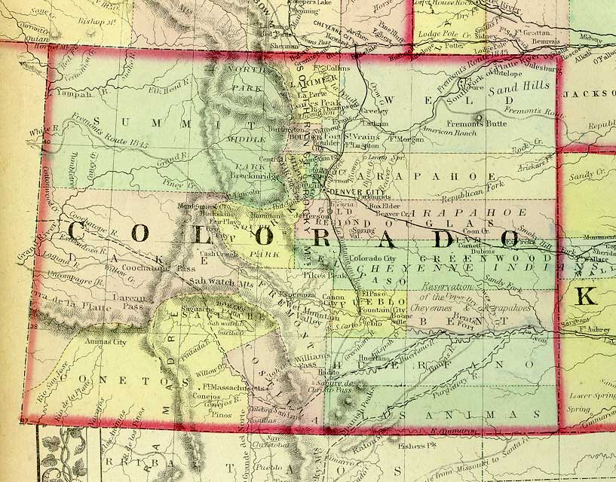
Maximum ABV
1.25%
This Photo by Unknown Author is licensed under CC BY-NC-SA

Slide 11
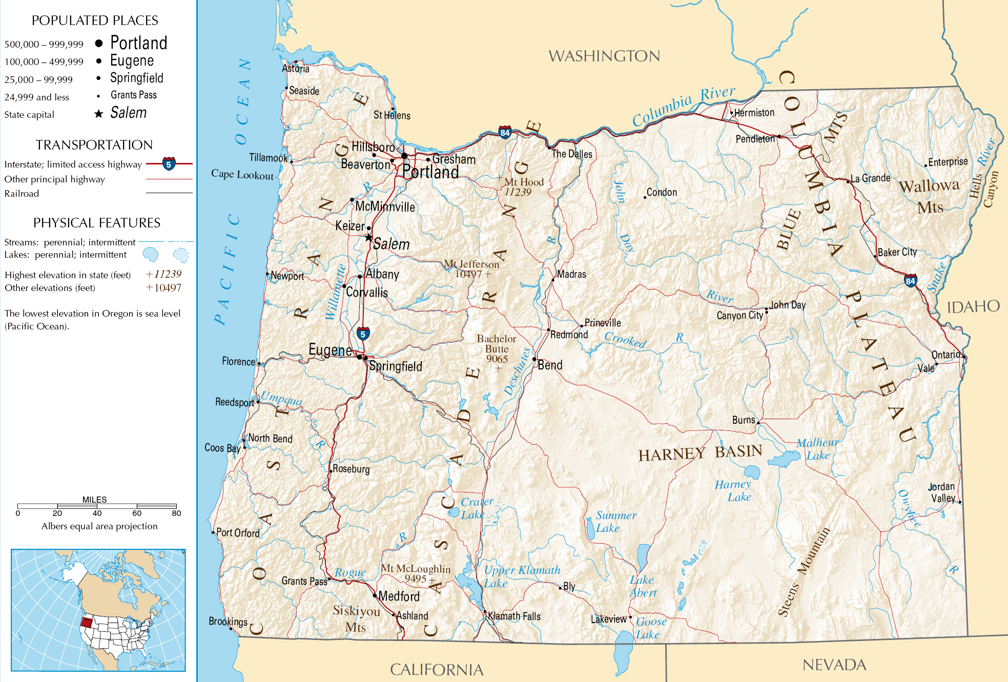
Most Bitter (IBU)
Add Count
This Photo by Unknown Author is licensed under CC BY-SA

Slide 12
Other Notable Information about ABV
Summary Stats about ABV from question 6

Slide 13
IBU vs ABV Relationship?
Insert scatterplot from question 7

Slide 14

Questions?

Slide 15
Thank You for allowing us to partner with you

